Slide 1
Introduction to
MANAGERIAL ECONOMICS

Slide 2
Managers in their day to day activities, are always confronted with the several issues such as :
How much quantity is to be produced
At what price
Make or buy decision
What will be the likely demand…etc
Managerial Economics provides basic insight into seeking solutions for managerial problems

Slide 3
As the name itself implies Managerial Economics is an offshoot of two distinct disciplines:
Economics &
Management

Slide 4
Economics is the social science that analyzes the production,distribution, and consumption of goods and services.
Economics is study of human activity both at individual and national level
Economics is derived from two Greek words which means house hold management
The term economics comes from the Ancient Greek οἰκονομία
(oikonomia,"management of a household, administration")
from οἶκος (oikos,"house") + νόμος (nomos, "custom" or "law)

Slide 5
Adam Smith the father of Economics defined Economics as
“The study of the nature & uses of national wealth”.
There are two branches in Economics Micro Economics & Macro Economics.
The study of individual firm is Micro Economics also called theory of firm
The study of total level of economic activity in a country is called Macro Economics.

Slide 6
Management is the science & art of getting things done through others.
Management includes several functions such as:
Planning
Organizing
Staffing
Directing
Coordinating
Regulating
Budgeting & Motivating ….etc

Slide 7
Definition of Managerial Economics
“The integration of economic theory with the business practice for the purpose of facilitating decision making & foreword planning by management”. Spencer & Siegel man
Supplement notes
Managerial economics refers to application of principles of Economics to solve the managerial problems such as Minimizing the cost or Maximizing profit.

Slide 8
Managerial economics directs the utilization of scarce resources in a goal oriented manner.
Seeks to understand & analyze the problems of business decision making.
Facilitates foreword planning.
Examines how an organization can achieve its objectives in most effectively.
Focuses on Minimizing the cost & Maximizing the profit.

Slide 9
Nature of Managerial economics
Close to Micro economics: Managerial economics is concerned with the finding solutions for different managerial problems of a particular firm, thus it is more close to Micro economics.
Operates against the backdrop of Macro economics: Manager of a firm has to be aware of the limits set by the economic conditions such as government industrial policies, monetary policy, fiscal policy, foreign trade policy inflation and so on.

Slide 10
Interdisciplinary in nature:
The tools, techniques & contents of Managerial economics are drawn from different disciplines such as Economics, Management, Statistics, Psychology, Accounting, Organizational behavior, Sociology Etc….
Offers scope to evaluate each alternative: Managerial economics provide an opportunity to evaluate each alternative in terms of cost & revenues, the manager of a firm can decide which is the best alternative to maximize the profit for the firm.

Slide 11
Scope of Managerial Economics:
Or subject matter of Managerial Economics.

Slide 12
Subject matter of Managerial Economics consists of applying economic principles & concepts towards adjusting various uncertainties faced by the business firms, such as
Demand uncertainty
Cost uncertainty
Price uncertainty
profit uncertainty
Production uncertainty

Slide 13
The scope of managerial economics refers to its area of study.
The scope of managerial economics covers two areas of decision making.
Operational or Internal issues
Environmental or External issues

Slide 14
Operational or Internal issues
Operational issues refer to those, which wise within the business organization and they are under the control of the management. Those are:
Theory of demand and Demand Forecasting
Pricing and Competitive strategy
Production cost analysis
Resource allocation
Profit analysis
Capital or Investment analysis
Strategic planning

Slide 15
1. Demand Analysis and Forecasting:
A firm can survive only if it is able to forecast demand for its product at the right time, within the right quantity. Understanding the basic concepts of demand is essential for demand forecasting.
Demand analysis also highlights for factors, which influence the demand for a product. This helps to manipulate demand.

Slide 16
2. Pricing and competitive strategy:
Pricing decisions have been always within the preview of managerial economics. Pricing policies are merely a subset of broader class of managerial economic problems. Price theory helps to explain how prices are determined under different types of market conditions. Competitions analysis includes the anticipation of the response of competitions the firm’s pricing, advertising and marketing strategies. Product line pricing and price forecasting occupy an important place here.

Slide 17
3. Production and cost analysis:
Production analysis is in physical terms. While the cost analysis is in monetary terms cost concepts and classifications, cost-out-put relationships, economies and diseconomies of scale and production functions are some of the points constituting cost and production analysis.

Slide 18
4. Resource Allocation:
Managerial Economics is the traditional economic theory that is concerned with the problem of optimum allocation of scarce resources. Marginal analysis is applied to the problem of determining the level of output, which maximizes profit. In this respect linear programming techniques has been used to solve optimization problems. In fact lines programming is one of the most practical and powerful managerial decision making tools currently available.

Slide 19
5. Profit analysis:
Profit making is the major goal of firms. There are several constraints here an account of competition from other products, changing input prices and changing business environment hence in spite of careful planning, there is always certain risk involved. Managerial economics deals with techniques of averting of minimizing risks. Profit theory guides in the measurement and management of profit, in calculating the pure return on capital, besides future profit planning.

Slide 20
. Capital or investment analyses:
Capital is the foundation of business. Lack of capital may result in small size of operations. Availability of capital from various sources like equity capital, institutional finance etc. may help to undertake large-scale operations. Hence efficient allocation and management of capital is one of the most important tasks of the managers. The major issues related to capital analysis are:
The choice of investment project
Evaluation of the efficiency of capital
Most efficient allocation of capital
Knowledge of capital theory can help very much in taking investment decisions. This involves, capital budgeting, feasibility studies, analysis of cost of capital etc.

Slide 21
7. Strategic planning:
Strategic planning provides management with a framework on which long-term decisions can be made which has an impact on the behavior of the firm. The firm sets certain long-term goals and objectives and selects the strategies to achieve the same. Strategic planning is now a new addition to the scope of managerial economics with the emergence of multinational corporations. The perspective of strategic planning is global.
It is in contrast to project planning which focuses on a specific project or activity. In fact the integration of managerial economics and strategic planning has given rise to be new area of study called corporate economics.

Slide 22
B. Environmental or External Issues:
An environmental issue in managerial economics refers to the general business environment in which the firm operates
A study of economic environment should include:
The type of economic system in the country.
The general trends in production, employment, income, prices, saving and investment.
Trends in the working of financial institutions like banks, financial corporations, insurance companies
Magnitude and trends in foreign trade;
Trends in labour and capital markets;
Government’s economic policies viz. industrial policy monetary policy, fiscal policy, price policy etc.

Slide 23
summary
The environmental or external issues relate managerial economics to macro economic theory while operational issues relate the scope to micro economic theory. The scope of managerial economics is ever widening with the dynamic role of big firms in a society.

Slide 24
Managerial economics relationship with other disciplines:

Slide 25
Managerial economics is closely linked with many other disciplines such as
Economics
Mathematics
Statistics
Operations Research
Accountancy
Psychology
Organizational behavior

Slide 26
Relationship with economics:
Managerial economics is the off shoot of ECONOMICS & hence concepts of Managerial economics are basically economic concepts.
Economics deals with theoretical concepts where as Managerial economics is concerned with application of these in real life.
Both Managerial economics & economics are concerned with problem of scarcity & resource allocation.

Slide 27
Managerial Economics and mathematics:
Managerial economist is concerned with estimating and predicting various economic factors for purpose of decision making & planning.
In this process Managerial economist extensively makes use of tools & techniques of Mathematics such as
Algebra
Calculus
Exponentials
Vectors etc..

Slide 28
Managerial Economics and Statistics:
Statistics deals with various techniques which are useful to analyse CAUSE & EFFECT relationship.
Tools & techniques such as
Averages Time series
Probability Correlation
Interpolation Regression
Above mentioned techniques are used by the managerial economist to deal with situations of risk & uncertanity.

Slide 29
M.E and Operations Research
Operation research discipline has many tools which helps the managerial economist to find solutions for many managerial problems.
The O.R Models such as
Linear programming
Queuing theory
Transportation problem
Project management techniqus PERT, CPM & so on extensively used in solving managerial problems.

Slide 30
Relationship with Accountancy
Accountancy provides information relating to COST’S, REVENUES, RECEIVABLES, PAYABLES, PROFIT&LOSSES and etc, this forms the basis for the managerial economist to act upon.
->Managerial economist depends upon the accounting data for decision making & planning.

Slide 31
Relationship with Psychology
Consumer Psychology is the basis on which managerial economist acts upon.
Example: how customer reacts to given change in the price.
Psychology contribute towards understanding the ATTITUDES & MOTIVATIONS of each micro economic variable such as consumer, seller/supplies etc.

Slide 32
Relationship with Organizational behavior
Organisational behaviour enables the managerial economist to study & develop behavioural models of the firm, integrating the managers behaviour with that of the owners.

Slide 33
summary
To conclude, managerial economics, which is an offshoot traditional economics, has gained strength to be a separate branch of knowledge. It strength lies in its ability to integrate ideas from various specialized subjects to gain a proper perspective for decision-making.
A successful managerial economist must be a mathematician, a statistician and an economist. He must be also able to combine philosophic methods with historical methods to get the right perspective only then; he will be good at predictions. In short managerial practices with the help of other allied sciences.

Slide 34
DEMAND ANALYSIS

Slide 35
What is Demand ?
Demand: desire for a commodity or service backed by purchasing power (ability to pay) & willingness to pay for it is called Demand.
A product or service is said to have demand when the following three conditions are satisfied.
Desire on the part of buyer to buy.
Ability to pay the specified price for it (purchasing power)
Willingness to pay for it
Unless all these conditions are satisfied the product/service is not said to have demand

Slide 36
FACTORS DETERMINING DEMAND

Slide 37
PRICE OF THE PRODUCT
INCOME LEVEL OF THE CONSUMER
TASTE & PREFERENCES OF THE CONSUMERS
PRICE OF RELATED GOODS (SUBSTITUTES)
EXPECTATIONS ABOUT THE PRICES IN THE FUTURE
EXPECTATIONS ABOUT THE INCOMES IN THE FUTURE
SIZE OF POPULATION
ADVERTISING EFFORTS
DISTRIBUTION OF CONSUMERS OVER DIFFERENT REGIONS.

Slide 38
DEMAND FUNCTION
Demand function explains the functional relationship between quantity demanded and the various factors that determine demand.
Demand function can be expressed mathematically as follows
Dn = f (Pn,I,T)
Here Dn = quantity demanded
f = functional relationship
Pn = price of the product
I = income of the consumer
T = taste & preference of the consumer

Slide 39
DEMAND SCHEDULE
Demand Schedule: it shows functional relationship between the quantity demanded of a product & its price.
i.e. demand schedule shows different quantities of a commodity demanded at various prices at a given time.
Price of Apple (In. Rs.) | Quantity Demanded
10 | 1
8 | 2
6 | 3
4 | 4
1 | 5

Slide 40
LAW of Demand

Slide 41
introduction
Law of demand shows the relation between price and quantity demanded of a commodity in the market.
In the words of Marshall, “the amount of demand increases with a fall in price and diminishes with a rise in price”.

Slide 42
The law of demand may be explained with the help of the following demand schedule.
Demand Schedule.
Price of Apple (In. Rs.) | Quantity Demanded
10 | 1
8 | 2
6 | 3
4 | 4
2 | 5

Slide 43
When the price falls from Rs. 10 to 8 quantity demand increases from 1 to 2. In the same way as price falls, quantity demand increases on the basis of the demand schedule we can draw the demand curve.
The demand curve DD shows the inverse relation between price and quantity demand of apple. It is downward sloping.

Slide 44
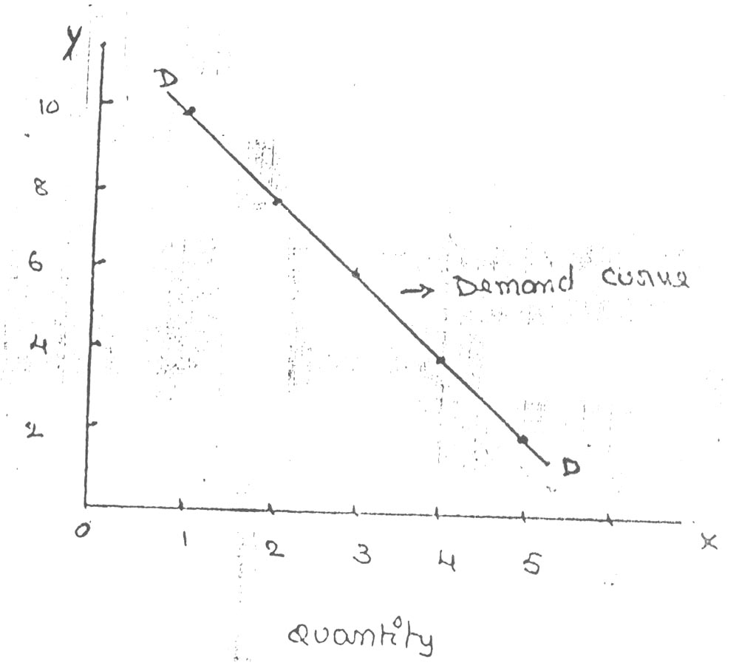

Slide 45
Assumptions of LAW of Demand
Law of demand is based on certain assumptions:
This is no change in consumers taste and preferences.
Income should remain constant.
Prices of other goods should not change.
There should be no substitute for the commodity
The commodity should not confer at any distinction
The demand for the commodity should be continuous
People should not expect any change in the price of the commodity.

Slide 46
EXCEPTIONS TO LAW OF DEMAND

Slide 47
Veblen goods or luxury goods
‘Veblan’ has explained the exceptional demand curve through his doctrine of conspicuous consumption. Rich people buy certain good because it gives social distinction or prestige for example diamonds are bought by the richer class for the prestige it possess. It the price of diamonds falls poor also will buy is hence they will not give prestige. Therefore, rich people may stop buying this commodity.

Slide 48
Ignorance
Sometimes, the quality of the commodity is Judge by its price. Consumers think that the product is superior if the price is high. As such they buy more at a higher price.

Slide 49
Speculative effect
If the price of the commodity is increasing the consumers will buy more of it because of the fear that it increase still further, Thus, an increase in price may not be accomplished by a decrease in demand.

Slide 50
Fear of shortage
During the times of emergency of war People may expect shortage of a commodity. At that time, they may buy more at a higher price to keep stocks for the future.

Slide 51
Necessaries:
In the case of necessaries like rice, vegetables etc. people buy more even at a higher price.

Slide 52
Giffen paradox:
The Giffen good or inferior good is an exception to the law of demand. When the price of an inferior good falls, the poor will buy less and vice versa. For example, when the price of maize falls, the poor are willing to spend more on superior goods than on maize if the price of maize increases, he has to increase the quantity of money spent on it. Otherwise he will have to face starvation. Thus a fall in price is followed by reduction in quantity demanded and vice versa. “Giffen” first explained this and therefore it is called as Giffen’s paradox.

Slide 53
ELASTICITY OF DEMAND

Slide 54
Introduction
The law of demand explains the direction of change in the quantity demanded, due to the changes in the price in case of normal goods.
Law of demand explains only the direction but not magnitude of change i.e.,
Law of demand does not explain how much quantity demanded will change, in response to change in the price, the concept of ELASTICITY OF DEMAND explain this.

Slide 55
The concept of ELASTICITY OF DEMAND is very important to the Economic theory as it explains the extent to which the demand changes when the price changes.
ELASTICITY OF DEMAND in general it refers to PRICE ELASTICITY OF DEMAND.
ELASTICITY OF DEMAND is always negative (-) for NORMAL GOODS. This is due to inverse relationship between PRICE & DEMAND.

Slide 56
Definition of PRICE ELASTICITY OF DEMAND
Degree to which quantity demanded responds to a change in price is known as PRICE ELASTICITY OF DEMAND.
In other words, the PRICE ELASTICITY OF DEMAND is the ratio of percentage change in quantity demanded, to percentage change in price.

Slide 57
Mathematically it can be expressed as follows
PRICE ELASTICITY OF DEMAND (Ep) =
Percentage change in quantity demanded /Percentage change in price.
OR
(Ep) = Proportionate change in quantity demanded / Proportionate change in price.
Proportionate change in quantity demanded =change in demand / initial demand
Proportionate change in price = change in price / initial price

Slide 58
TYPES OF ELASTICITY OF DEAMAND
The following are various types of ELASTICITY OF DEAMAND
PRICE ELASTICITY OF DEMAND
INCOME ELASTICITY OF DEMAND
CROSS ELASTICITY OF DEMAND
ADVERTISEMENT ELASTICITY OF DEMAND

Slide 59
PRICE ELASTICITY OF DEMAND: it refers to the responsiveness of quantity demanded to changes in prices.
MEASUREMENT
PRICE ELASTICITY OF DEMAND (Ep):
(Ep) = Proportionate change in quantity demanded / Proportionate change in price.

Slide 60
INCOME ELASTICITY OF DEMAND: it refers to the responsiveness of quantity demanded to changes in the incomes of the consumers.
MEASUREMENT
INCOME ELASTICITY OF DEMAND
(Ei) = Proportionate change in quantity demanded / Proportionate change in income

Slide 61
CROSS ELASTICITY OF DEMAND: it refers to the responsiveness of quantity demanded to changes in the prices of the related goods, say which may be substitute goods.
MEASUREMENT
CROSS ELASTICITY OF DEMAND (Ec):
(Ec) = Proportionate change in quantity demanded / Proportionate change in prices of related goods.

Slide 62
ADVERTISEMENT ELASTICITY OF DEMAND: it refers to the responsiveness of quantity demanded to changes in the advertisement efforts & expenditure.
MEASUREMENT
ADVERTISEMENT ELASTICITY OF DEMAND (Ea):
(Ea) = Proportionate change in quantity demanded / Proportionate change in advertisement efforts or cost.

Slide 63
TYPES OF PRICE ELASTICITY OF DEMAND

Slide 64
Based on numerical values price elasticity of demand can be of five (5) types.
Perfectly elastic demand (Ep = α)
Perfectly inelastic demand (Ep = 0)
Unit elastic demand (Ep = 1)
Relatively elastic (Ep = > 1)
Relatively inelastic (Ep = < 1)

Slide 65
Perfectly elastic demand
Perfectly elastic demand is also called as infinitely elastic demand.
It means small change in price leads to an infinite expansion in demand.
Even if the price remain same the quantity demanded increases.
Perfectly elastic demand curve is horizontal straight line to X axis

Slide 66
Price
P
O
Q1
Q2
Demand
Perfectly elastic demand curve is horizontal straight line to X axis
Even if the price remain same the quantity demanded increases.

Slide 67
Perfectly inelastic demand
In perfectly inelastic demand even with a great fall or rise in the price the quantity demanded of the product does not change.
perfectly inelastic demand curve is vertical straight line parallel to Y axis

Slide 68
p
p1
o
m
perfectly inelastic demand curve is vertical straight line parallel to Y axis
What ever may be the change in the price high or low the quantity demanded is the same.

Slide 69
Unit elastic demand
Proportionate change in price leads to a proportionate change in quantity demand is called unit elastic demand.
If demand increases by 1% for a 1% fall in the price, the elasticity of demand is equal to 1.
When the change in demand is equal to change in price is called unit elasticity demand.

Slide 70
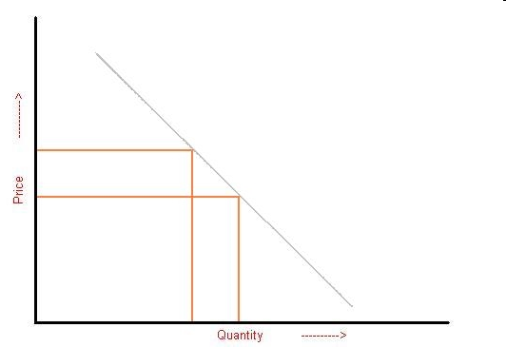

Slide 71
Relatively elastic
It means Proportionate change in price leads to more than proportionate change in quantity demanded is called Relative elastic demand.
If demand increases by more than 1% for a 1% fall in the price, the elasticity of demand is said to be Relative elastic demand.

Slide 72
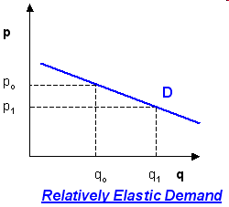

Slide 73
Relatively inelastic
It means Proportionate change in price leads to less than proportionate change in quantity demanded is called Relative inelastic demand.
If demand increases by less than 1% for a 1% fall in the price, the elasticity of demand is said to be Relative inelastic demand.

Slide 74
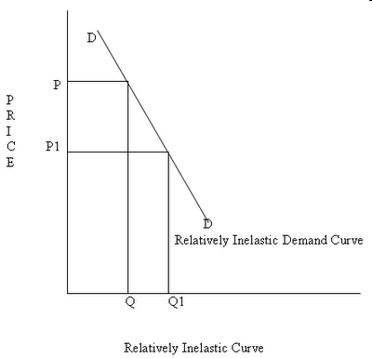

Slide 75
Importance of Elasticity of Demand:

Slide 76
The concept of elasticity of demand is very useful to the Producers and the Policy makers.
It is used to fix prices of goods.
To fix prices (rewards) of Factors of production.
To forecast demand. (income elasticity man be used to forecast demand for the product)
To plan the level of output & price.

Slide 77
1. Price fixation:
Each seller has to take into account elasticity of demand, while fixing the price for his product. If the demand for the product is inelastic, he can fix a higher price.

Slide 78
2.To fix prices of factors of production
Elasticity of demand also helps in the determination of rewards for factors of production. For example, if the demand for labour is inelastic, trade unions will be successful in raising wages. It is applicable to other factors of production.

Slide 79
3. Production:
Producers generally decide their production level on the basis of demand for the product. Hence elasticity of demand helps the producers to take correct decision regarding the level of out put to be produced.

Slide 80
4. Public Finance:
Elasticity of demand helps the government in formulating tax policies.
For example, for imposing tax on a commodity, the Finance Minister has to take into account the elasticity of demand.
If a commodity has inelastic demand increase in the tax on such commodity will generate revenue for the government.

Slide 81
5. International Trade:
The concept of elasticity of demand plays significant role in the international trade.
Much foreign exchange can be earned by exporting goods which has elastic demand.
Small reduction in price of goods result in good amount of foreign exchange.

Slide 82
DEMAND FORECASTING METHODS

Slide 83
WHY TO FORECAST DEMAND ?
To assess the likely demand.
To plan the production accordingly.
To plan the INPUTS (factors of productions) Manpower (labour), Raw material, and Capital.

Slide 84
Demand Forecasting Methods
Statistical
survey
other
Trend projection
methods
Survey of buyer
intentions
Expert opinion
Sales force opinion
Barometric
Test marketing
Correlation
Delphi method
Controlled
experiments
Regression
Self judgment
method

Slide 85
DEMAND FORECASTING METHODS
DEMAND FORECASTING METHODS are classified into
Survey methods
Statistical methods
Other methods

Slide 86
Survey methods
Survey of buyer intentions
Census method
Sample method
Sales force opinion method
Delphi Method

Slide 87
Statistical methods
Trend projection methods
Barometric techniques
Simultaneous equation method
Regression & correlation methods

Slide 88
Other methods
Expert opinion method
Test marketing
Controlled experiments
Judgmental approach

Slide 89
Survey of buyer intentions: in this method information is drawn from the buyer to estimate demand.
In this method each potential buyer is asked how much does he plan to buy, of the given product at a given point of time under particular condition.
This is the most effective method because the buyer is the ultimate decision maker, & we are collecting the information from the potential buyer.

Slide 90
Survey can be conducted by considering either whole population or by selecting a small group of potential buyers.
If survey is conducted by considering the whole population it is called CENSUS method. CENSUS method is also called as TOTAL ENUMERATION method.
If survey is conducted by considering the small group of potential buyers who can represent the whole population, it is called SAMPLE method.

Slide 91
2. Sales force opinion method: Sales people are in constant touch with the large number of buyers of a particular market.
Sales force constitute valid source of information about the likely sales of a product
Sales force is capable of assessing the likely reaction of the customers of their territories quickly, given the companies marketing strategy.

Slide 92
3.Delphi Method: A variant of the survey method is Delphi method. It is a sophisticated method to arrive at a consensus. Under this method, a panel is selected to give suggestions to solve the problems in hand. Both internal and external experts can be the members of the panel. Panel members one kept apart from each other and express their views in an anonymous manner. There is also a coordinator who acts as an intermediary among the panelists. He prepares the questionnaire and sends it to the panelist. At the end of each round, he prepares a summary report. On the basis of the summary report the panel members have to give suggestions.

Slide 93
1.Trend projection methods:
A well-established firm will have accumulated data. These data is analyzed to determine the nature of existing trend. Then, this trend is projected in to the future and the results are used as the basis for forecast.
There are five main techniques
Trend line by observation
Least square method
Time series analysis
Moving averages method
Exponential smoothing

Slide 94
2.Barometric technique: under this technique one set of data is used to predict another set.
In other words to forecast demand for a product , some other relevant indicator, which is known as BAROMETER is used to forecast the future demand.
E.g.. To forecast demand for cement the relevant indicator number of new construction projects, are taken into consideration for forecasting demand.

Slide 95
3.Correlation describes the degree of association between two variables such as sales and advertisement expenditure.
When two variables tend to change together then they are said to be correlated.
The extent to which they are correlated is measured by correlation coefficient.
For example if sales have gone up as a result of increase in advertisement expenditure we can say that sales and advertisement are positively correlated.

Slide 96
4.Regression analysis: A statistical measure that attempts to determine the strength of the relationship between one dependent variable (usually denoted by Y) and a series of other changing variables (known as independent variables).
The two basic types of regressions are linear regression and multiple regression. Linear regression uses one independent variable to explain and/or predict the outcome of Y, while multiple regression uses two or more independent variables to predict the outcome.

Slide 97
The general form of each type of regression is: Linear Regression: Y = a + bX + u Multiple Regression: Y = a + b1X1 + b2X2 + B3X3 + ... + BtXt + u Where: Y= the variable that we are trying to predict X= the variable that we are using to predict Y a= the intercept b= the slope u= the regression residual.

Slide 98
1.Expert opinion method: an expert is good at forecasting and analyzing the future trends for a given product or service at a given level of technology.
Apart from salesmen, consumers & distributors, outside experts may also used for forecasting. In the United States of America, the automobile companies get sales estimates directly from their dealers. Firms in advanced countries make use of outside experts for estimating future demand.

Slide 99
2.Test marketing: in test marketing the entire product and marketing program is carried for the first time in a small number of well chosen and authentic sales environment.
The primary objective of test marketing is to know whether the customer will accept the product in the present form or not

Slide 100
3.Controlled experiments: major determinants of demand are manipulated to suit to the customers with different tastes and preferences
In this method the product is introduced with different packages, different prices, in different markets to assess which combination appeals to the customer most

Slide 101
4.Judgmental approach: when none of statistical and other methods are directly related to the given product/service the management has no alternative other than using its own judgment in forecasting the demand.

